Slide 1
Laravel Framework
(15 hours)
Notes:
Title - The learning outcome
Subtitle - Duration

Slide 2
In this section, we will discuss:
Migrations in Laravel
Database Seed in Laravel
Handing Session in Controller and Views
.env File and its usage
Introduction to JetBrains (Livewire)
Notes:
Mention the parent topics one by one. This particular learning outcome has 5 parent topics.

Slide 3
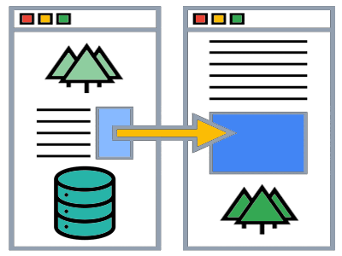
Migrations in Laravel
What is Laravel Migration?
Laravel migration is a process that enables you to build a table in a database without generally writing or modifying the SQL queries.
It allows you to roll back changes, make incremental changes or sync the database structure simultaneously when multiple teams work on the same application.
Image Source: https://vegibit.com/laravel-migration-generator/
Notes:
Left (White Color space):
Title - Parent Topic
Subtitle - Subtopic 1
Body Text - Description in bullets
Right (Grey Color Space):
Body Text - Relevant image (with source)/code snippet
Laravel Migration is an essential feature in Laravel that allows you to create a table in your database. It allows you to modify and share the application's database schema. You can modify the table by adding a new column or deleting an existing column.
Reference:
https://vegibit.com/laravel-migration-generator/

Slide 4
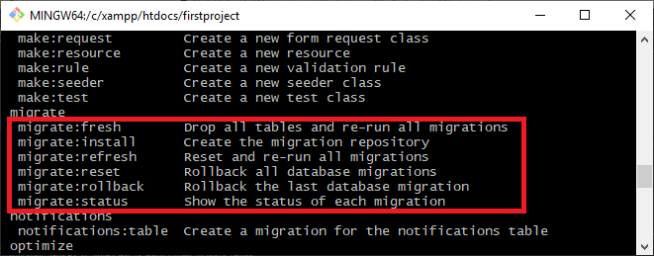
Migrations in Laravel
Laravel Migration Commands
migrate:fresh
migrate:install
migrate:refresh
migrate:reset
migrate:rollback
migrate:status
Image Source: https://www.javatpoint.com/laravel-migration-structure
Notes:
This slide talks about the case if we have to divide a subtopic further.
Left (White Color space):
Title - Parent Topic
Subtitle - Subtopic
Body Text - Description in bullets
Right (Grey Color Space):
Body Text - Relevant image (with source)/code snippet
There are six commands of migrate in Laravel:
migrate:fresh
migrate:install
migrate:refresh
migrate:reset
migrate:rollback
migrate:status
migrate:fresh
Using this command,one can drop all the tables from the database and re-run all the migrations
Syntax : php artisan migrate:fresh
migrate:install
Using this command, a migration table can be created in a database.
Syntax : php artisan migrate:install
migrate:refresh
Using this command,all the migrations can be rolled back,and migrations can be re-run.
In simple words,the database can be re-created entirely.
Syntax : php artisan migrate:refresh
migrate:reset
It solely drops all the tables that you have created in a database.
Syntax : php artisan migrate:reset
migrate:rollback
This laravel command is used to drop the last database migration.
Syntax:php artisan migrate:rollback
migrate:status
This command helps you check the migration status.
Syntax : php attisan migrate:status
Reference:
https://www.javatpoint.com/laravel-migration-structure

Slide 5
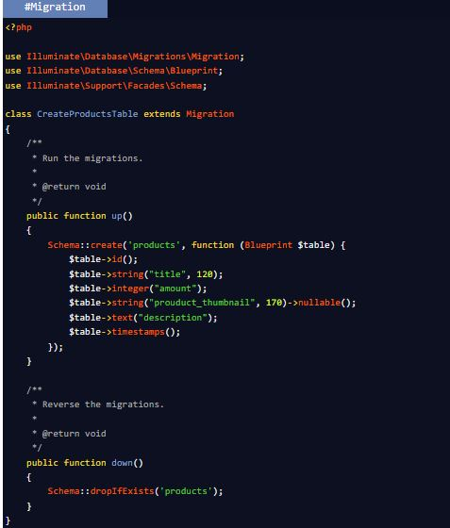
Migrations in Laravel
Migrate Specific Migration File in Laravel 8
When you create migrations in laravel, you also have command to migrate it and create tables schemas in database. Migration file is the file which creates the table structure.
When we use migrate command from artisan command list, it will run all migrations and create table. But in some cases we want to run only a specific migration instead to run all.
Notes:
Left (White Color space):
Title - Parent Topic
Subtitle - Subtopic
Body Text - Description in bullets
Right (Grey Color Space):
Body Text - Relevant image (with source)/code snippet
Reference:

Slide 6
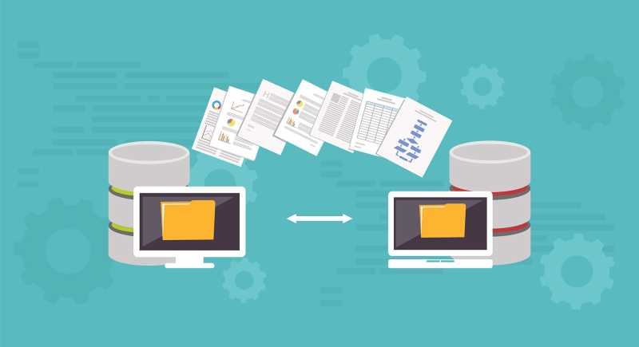
Database Seed in Laravel
What is Database Seeding?
Laravel provides a tool to add sample or dummy data to our databases automatically. which calls it database seeding.
Image Source: https://voyageapp.io/blog/programming/you-should-embrace-database-seeding
Notes:
Left (White Color space):
Title - Parent Topic
Subtitle - Subtopic 2
Body Text - Description in bullets
Right (Grey Color Space):
Body Text - Relevant image (with source)/code snippet
Database seeding means fill your database tables with the test data programmatically. With this approach, one can enter thousands of records in the database within a few minutes. It is an efficient way rather than doing it manually. You may want a dummy data to test out your application and seeding the database through the program saves you a ton of time.
Laravel includes the ability to seed your database with test data using seed classes. All seed classes are stored in the database/seeders directory. By default, a Database Seeder class is defined for you. From this class, you may use the call method to run other seed classes, allowing you to control the seeding order
Reference:
https://voyageapp.io/blog/programming/you-should-embrace-database-seeding

Slide 7
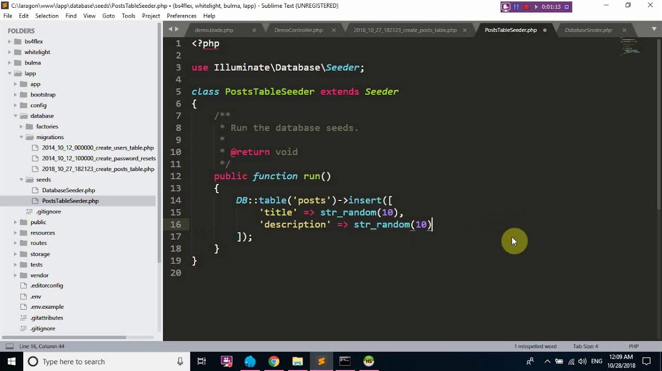
Database Seed in Laravel
Create a Database Seeder
To create database seeder, we will below steps
Install Laravel 8
Create Seeder
Write Code in Seeder
Run the Seeder
Image Source: https://voyageapp.io/blog/programming/you-should-embrace-database-seeding
Notes:
This slide talks about the case if we have to divide a subtopic further.
Left (White Color space):
Title - Parent Topic
Subtitle - Subtopic 1
Body Text - Description in bullets
Right (Grey Color Space):
Body Text - Relevant image (with source)/code snippet
Create Database Seeder
To create database seeder, we will below steps
Install Laravel 8
Create Seeder
Write Code in Seeder
Run the Seeder
Reference:
https://voyageapp.io/blog/programming/you-should-embrace-database-seeding

Slide 8
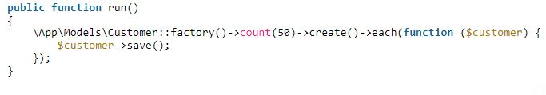
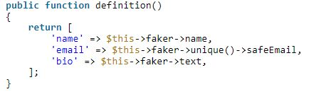
Database Seed in Laravel
Seeding a Database
Seeding a database in Laravel requires you to follow a few steps which are
writing seeders
creating a model factory
running seeders
Notes:
Left (White Color space):
Title - Parent Topic
Subtitle - Subtopic 1
Body Text - Description in bullets
Right (Grey Color Space):
Body Text - Relevant image (with source)/code snippet
Laravel offers a tool to include dummy data to the database automatically. This process is called seeding. Developers can add simply testing data to their database table using the database seeder. It is extremely useful as testing with various data types allows developers to detect bugs and optimize performance
Writing Seeders
To generate a seeder, execute the make:seeder Artisan command. All seeders generated by the framework will be placed in the database/seeders directory:
php artisan make:seeder UserSeeder
<?php
namespace Database\Seeders;
use Illuminate\Database\Seeder;
use Illuminate\Support\Facades\DB;
use Illuminate\Support\Facades\Hash;
use Illuminate\Support\Str;
class DatabaseSeeder extends Seeder
{
/**
* Run the database seeders.
*
* @return void
*/
public function run()
{
DB::table('users')->insert([
'name' => Str::random(10),
'email' => Str::random(10).'@gmail.com',
'password' => Hash::make('password'),
]);
}
}
Using Model Factories
Of course, manually specifying the attributes for each model seed is cumbersome. Instead, you can use model factories to conveniently generate large amounts of database records
Using Model Factories
use App\Models\User;
/**
* Run the database seeders.
*
* @return void
*/
public function run()
{
User::factory()
->count(50)
->hasPosts(1)
->create();
}
Running Seeders
You may execute the db:seed Artisan command to seed your database. By default, the db:seed command runs the Database\Seeders\DatabaseSeeder class, which may in turn invoke other seed classes. However, you may use the --class option to specify a specific seeder class to run individually:
php artisan db:seed
php artisan db:seed --class=UserSeeder
You may also seed your database using the migrate:fresh command in combination with the --seed option, which will drop all tables and re-run all of your migrations. This command is useful for completely re-building your database:
php artisan migrate:fresh –seed
Reference:

Slide 9
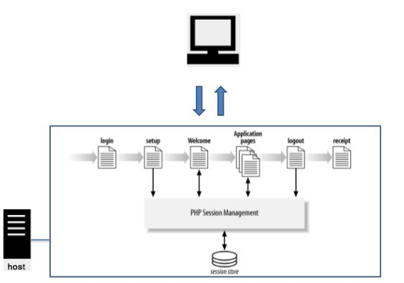
Handing Session in Controller and Views
Laravel Session
Laravel session is a way of storing the user information across the multiple user requests. It keeps track of all the users that visit the application.
Image Source: https://medium.com/@kaythinks/user-authentication-in-laravel-using-session-f23790c8208e
Notes:
Left (White Color space):
Title - Parent Topic
Subtitle - Subtopic 1
Body Text - Description in bullets
Right (Grey Color Space):
Body Text - Relevant image (with source)/code snippet
Laravel session is a way of storing the user information across the multiple user requests. It keeps track of all the users that visit the application. Let's understand the session through an example. First, we create a form on which we apply the properties of the session.
Reference:
https://medium.com/@kaythinks/user-authentication-in-laravel-using-session-f23790c8208e

Slide 10
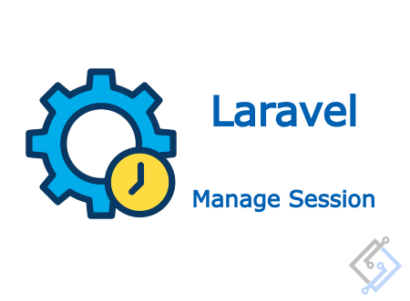
Laravel Session
Session
Storing the data in a session
Global Session Helper
Retrieving all session data
Deleting the session
Image Source: https://medium.com/@kaythinks/user-authentication-in-laravel-using-session-f23790c8208e
Notes:
Left (White Color space):
Title - Parent Topic
Subtitle - Subtopic
Body Text - Description in bullets
Right (Grey Color Space):
Body Text - Relevant image (with source)/code snippet
Reference:
https://medium.com/@kaythinks/user-authentication-in-laravel-using-session-f23790c8208e

Slide 11
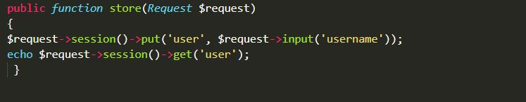
Laravel Session
Storing the data in a session
To store the user name in a session, we use the put() method of session as shown below:
$request->session()->put('user', $request->input('username’));
Notes:
Continuing from the last slide:
Left (White Color space):
Title - Parent Topic
Subtitle – Subtopic divisions (Subtopics of subtopics)
Body Text - Description in bullets
Right (Grey Color Space):
Body Text - Relevant image (with source)/code snippet
To store the user name in a session, we use the put() method of session as shown below:
$request->session()->put('user', $request->input('username'));
To retrieve the session, we use the get() method of session as shown below:
echo $request->session()->get('user');
Reference:

Slide 12
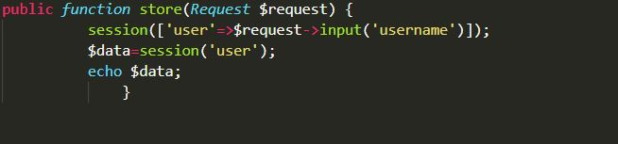
Laravel Session
Global Session Helper
We can also use the global session function that stores and retrieves the value in a session.
When the session function is passed with a single parameter, then it returns the value of the key.
If the session is passed with an array of key/value pairs, then the values are stored in the session
Notes:
Left (White Color space):
Title - Parent Topic
Subtitle - Subtopic divisions (Subtopics of subtopics)
Body Text - Description in bullets
Right (Grey Color Space):
Body Text - Relevant image (with source)/code snippet
We can also use the global session function that stores and retrieves the value in a session. When the session function is passed with a single parameter, then it returns the value of the key. If the session is passed with an array of key/value pairs, then the values are stored in the session.
// Retrieve a data from the session key.
$data=session('key');
//Providing a default value to the session key.
$data=session('key', 'default');
// Storing the value in the session key.
session(['key'=>'value']);
Reference:

Slide 13
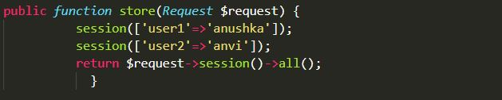
Laravel Session
Retrieving all session data
If we want to retrieve all the session data, then we can use the all() method as shown below:
$session_data = $request->session()->all();
Notes:
Left (White Color space):
Title - Parent Topic
Subtitle - Subtopic divisions (Subtopics of subtopics)
Body Text - Description in bullets
Right (Grey Color Space):
Body Text - Relevant image (with source)/code snippet
If we want to retrieve all the session data, then we can use the all() method as shown below:
$session_data = $request->session()->all();
Reference:

Slide 14
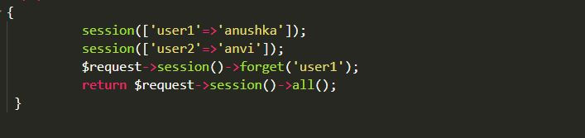
Laravel Session
Deleting the session
We can delete the session by using the forget() method.
Notes:
Left (White Color space):
Title - Parent Topic
Subtitle - Subtopic divisions (Subtopics of subtopics)
Body Text - Description in bullets
Right (Grey Color Space):
Body Text - Relevant image (with source)/code snippet
Now, we will see how to delete the data from the session. We can delete the session by using the forget() method
Reference:

Slide 15
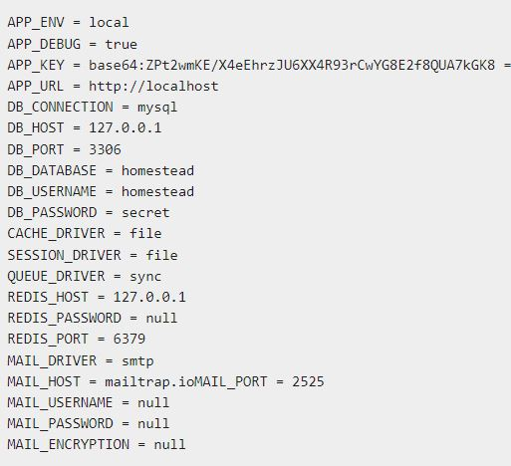
.env File and its usage
Environment Configuration
Environment variables are those which provide a list of web services to your web application.
All the environment variables are declared in the .env file which includes the parameters required for initializing the configuration.
Notes:
Left (White Color space):
Title - Parent Topic
Subtitle - Subtopic
Body Text - Description in bullets
The .env file should not be committed to the application source control, since each developer or user has some predefined environment configuration for the web application.
For backup options, the development team should include the .env.example file, which should contain the default configuration.
Right (Grey Color Space):
Body Text - Relevant image (with source)/code snippet
Reference:

Slide 16
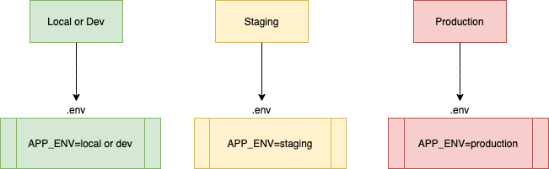
.env File and its usage
What is .env file in Laravel 8?
Laravel's default .env file contains some common configuration values that may differ based on whether your application is running locally or on a production web server.
Image Source: https://learn2torials.com/a/laravel8-config-env-files
Notes:
This slide talks about the case if we have to divide a subtopic further.
Left (White Color space):
Title - Parent Topic
Subtitle - Subtopic
Body Text - Description in bullets
Right (Grey Color Space):
Body Text - Relevant image (with source)/code snippet
Laravel's default .env file contains some common configuration values that may differ based on whether your application is running locally or on a production web server.
Laravel also provides you. env.example file where you can only put placeholder keys so that different developer or environment can use different values according to their need.
Do not add sensitive information either in. env or. env.example file that would create security issue and some hacker can easily sniff this type of data from your repository.
Reference:
https://learn2torials.com/a/laravel8-config-env-files

Slide 17
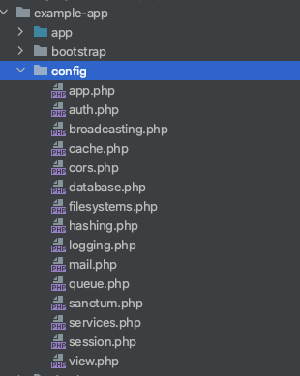
.env File and its usage
What are configuration files in Laravel 8?
These configuration files allow you to configure things like your database connection information, your mail server information, as well as various other core configuration values.
Notes:
Left (White Color space):
Title - Parent Topic
Subtitle - Subtopic 1
Body Text - Description in bullets
Right (Grey Color Space):
Body Text - Relevant image (with source)/code snippet
These configuration files allow you to configure things like your database connection information, your mail server information, as well as various other core configuration values.
All of the configuration files for the Laravel framework are stored in the config directory.
Reference:

Slide 18
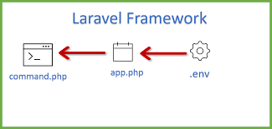
.env File and its usage
What is the use of .ENV file?
Environment File Security
Accessing Configuration Values
Retrieval of Environment Variables
Caching of Configuration
Maintenance & Debug Mode
Image Source: https://www.getsetsolution.com/solved-how-to-read-value-from-env-file
Notes:
Left (White Color space):
Title - Parent Topic
Subtitle - Subtopic 1
Body Text - Description in bullets
Right (Grey Color Space):
Body Text - Relevant image (with source)/code snippet
env file. It's actually a simple configuration text file that is used to define some variables you want to pass into your application's environment. This file needs a something like a parser to make it work. The parser reads the variable definitions one-by-one and parses them to the environment.
. env file, as its name suggest, is a local where you put all your environment setup, such as database credentials, cache drivers and etc. Everything that is about the server that the project is running, and may have different values for different servers, are setup here
Reference:
https://www.getsetsolution.com/solved-how-to-read-value-from-env-file

Slide 19
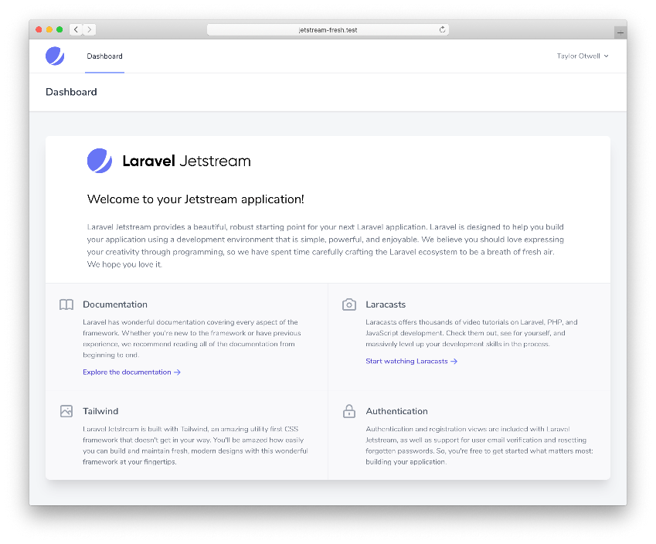
Introduction to JetBrains(Livewire)
Laravel Jetstream
Laravel Jetstream is a beautifully designed application starter kit for Laravel and provides the perfect starting point for your next Laravel application
Image Source: https://jetstream.laravel.com/2.x/introduction.html
Notes:
Left (White Color space):
Title - Parent Topic
Subtitle - Subtopic 1
Body Text - Description in bullets
Right (Grey Color Space):
Body Text - Relevant image (with source)/code snippet
Laravel Jetstream is a beautifully designed application starter kit for Laravel and provides the perfect starting point for your next Laravel application. Jetstream provides the implementation for your application's login, registration, email verification, two-factor authentication, session management, API via Laravel Sanctum, and optional team management features.
Reference:
https://jetstream.laravel.com/2.x/introduction.html

Slide 20

Introduction to JetBrains(Livewire)
Laravel Livewire
Laravel Livewire is a library that makes it simple to build modern, reactive, dynamic interfaces using Laravel Blade as your templating language
Image Source: https://laravel-livewire.com/
Notes:
Left (White Color space):
Title - Parent Topic
Subtitle - Subtopic 1
Body Text - Description in bullets
Right (Grey Color Space):
Body Text - Relevant image (with source)/code snippet
Livewire is a full-stack framework that helps the developer for building dynamic interfaces. Every business looks for modern app development. This development becomes much hard with tools like Reach and Vue. Though these tools and extremely powerful, the complexity causes fatigue.
Livewire comes with the comfort of Laravel. If you will into its codes, you can find out the difference and uniqueness of performance. It keeps improving with the real-time search component that the user sees after typing into the search input.
It works swiftly and the performance is here –
SEO friendly performance with the page
AJAX request to the server at an interaction
Mutates DOM as the things changed
Reference:
https://laravel-livewire.com/

